Slide 1
Green Hydrogen in India
Unlocking Potential Amid Global Headwinds
SANTOSH KUMAR SARANGI, SECRETARY, MNRE
ICGH 2025
11 November 2025

Slide 2
Agenda
India’s Advantage: Low-Cost Renewables, Global Partnerships
  Energy independence and industrial competitiveness
  National Green Hydrogen Mission: Laying the foundation for scale
  Investment in R&D, hydrogen valleys and pilot projects
Market Realignment: India’s Strategic Edge in a Changing Global Landscape
  Global slowdown and recalibration
  India’s cost advantage and export readiness
Early Projects Anchored in Emerging Markets
  Expanding demand beyond fertilisers
  Capturing early-mover advantage in export markets
Enablers: Path from Potential to Scale
  Infrastructure, standards, partnerships, and de-risking
  Port-based industrial hubs driving cost efficiency
Shipping and Trade Corridors: Extending India’s Green Reach
  Rotterdam–VOC–Singapore and coastal corridors
  Policy alignment for cost parity and competitiveness
India’s Next Phase of Growth and Innovation
  Channeling efforts toward clusters, corridors, and commercial projects

Slide 3
India’s Advantage: Low-Cost Renewables, Global Partnerships

Slide 4




Green hydrogen is strengthening India's energy security and global competitiveness
Energy Independence and Security
Industrial Transformation & Competitiveness
Economic Growth and Job Creation
Global Trade and Export Opportunities
Replaces imported fossil fuels with clean hydrogen
Cuts crude oil, gas, and ammonia imports (> $160 bn/yr)
Strengthens energy resilience against global price shocks
Decarbonises hard-to-abate sectors (steel, fertilisers, refining)
Builds low-carbon manufacturing ecosystems
Attracts global green-supply investments
$100 bn investment opportunity across hydrogen value chain
New manufacturing and service industries
Millions of clean-energy jobs
Positions India as a key exporter of green hydrogen & derivatives
Access to early-mover markets (EU, Japan, Singapore)
Boosts participation in global green trade

Slide 5
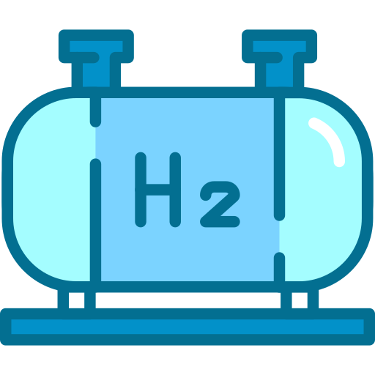
National Green Hydrogen Mission is building the foundation for scale
Budget Allocations
Expected Outcomes for Green Hydrogen
Others: US$ 46 million
Production capacity will reach at least 5 MMT Per Annum
2
Skill Dev.: US$ 4 million
1
Renewable Energy Capacity Addition of ~125GW
R&D:
US$ 50 million
60-100 GW electrolyser installations
4
3
Over INR 8 lakh Crore in total investment
Pilots: US$ 175 million
Total Outlay: US$ 2.4 Billion
Hubs:
US$ 50 million
Create over 6 lakh full time jobs
5
50MMT Per annum of CO₂ emissions are expected to be averted
6
SIGHT: US$ 2100 million

Slide 6
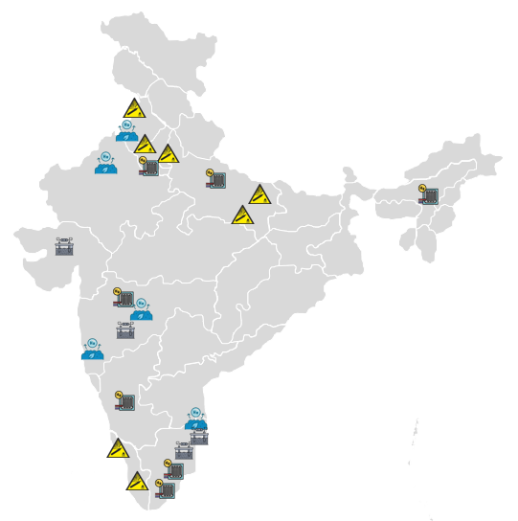
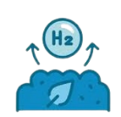


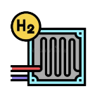
Driving Innovation Through Strategic R&D Investments
INR 400 Crore R&D outlay (2023–26): Supporting 23+ projects across safety, biomass, applications, and non-biomass hydrogen production, with over 100 CoE proposals under review.
Thapar Institute of Engineering & Technology
Engineers India Limited
Indian Institute of Technology Ropar
Indian Institute of Technology Kanpur
Shriram Institute for Industrial Research
Indian Institute of Technology (BHU) Varanasi
Birla Institute of Technology and Science - Pilani, Pilani Campus
Shigan Nexgen Technologies Private Limited
Hypace Solutions Private Limited
GFCL Solar and Green Hydrogen Products Limited
Indian Institute of Technology (BHU) Varanasi + IIT Hyderabad
Texol Energy Private Limited
Automotive Research Association of India
CSIR-National Chemical Laboratory
Production Category (Biomass)
CSIR - Central Electrochemical Research Institute
Institute of Chemical Technology, Mumbai
Production Category (Non Biomass)
SRM Institute of Science & Technology
Hylan Power One Pvt. Ltd.
Safety, Cross Cutting Analysis & Integration
Indian Institute of Science Education and Research
CSIR-Central Electrochemical Research Institute, Karaikudi
Mahindra and Mahindra Ltd
Applications Category
CSIR-National Institute for Interdisciplinary Science and Technology (NIIST)
Magic Myna Private Limited

Slide 7




Hydrogen Valleys: Building Integrated Regional Ecosystems
Hydrogen Valleys act as integrated demonstration hubs, linking production, storage, and end-use.
Total Investment: ₹485.3 Cr | GoI: ₹169.9 Cr and Industry: ₹315.4 Cr
Jodhpur - HVIC
Location HVIC: IIT Jodhpur
Lead Applicant: IIT Jodhpur
Production Route: Electrolysis
Utilization: Transport - H2ICE; Hydrogen Blending; Ammonia Production
Funds Distribution (₹ Cr): Total (175.1) – GoI: 36.5 and Industry: 138.6
Bhubaneshwar - HVIC
Location HVIC: IIT Bhubaneswar
Lead Applicant: IIT Bhubaneswar
Production Route: Electrolysis
Utilization: DRI – Green Steel; Transportation – Mining Truck
Funds Distribution (₹ Cr): Total (51.7) – GoI: 37.4 and Industry: 14.25
Pune - HVIC
Location HVIC: Pune-Mumbai region
Lead Applicant: CSIR – NCL
Production Route: Bio-ethanol, Electrolysis
Utilization: Fine/Specialty Chemicals; Transport - Bus
Funds Distribution (₹ Cr): Total (125.9) – GoI: 42.6 and Industry: 82.8
ANERT - HVIC
Location HVIC: Kochi
Lead Applicant: ANERT (State Government Agency for Energy, recognized by MNRE)
Production Route: Electrolysis
Utilization: Transport – Road and Waterways; City gas Blending; Ammonia Production
Funds Distribution (₹ Cr): Total (133.2) – GoI: 53.4 and Industry: 79.78

Slide 8
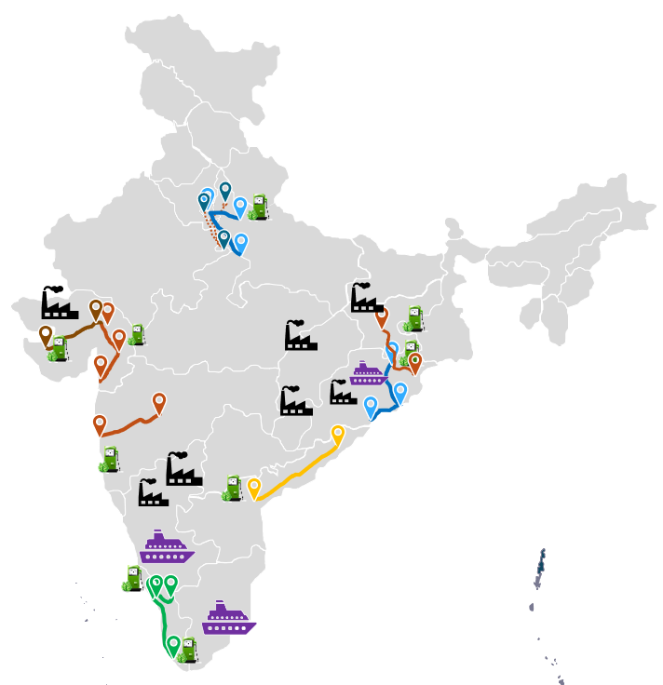


Piloting First-of-Its-Kind Applications Across Sectors
Transport Consortium Routes
Chhattisgarh
Steel Plant
NTPC (With Buses manufactured by AL
Tata Motors + IOCL
Hazira
Steel Plant
Angul
Steel Plant
ANERT + BPCL
Sahibabad
Delhi
Gr. Noida
RIL + AL
Bokaro
Steel Plant
HPCL + Volvo
Faridabad
Agra
Jamshedpur
Shipping
Ahmedabad
Kolkata
Retrofitting of Ships
Jamnagar
Vadodara
Bhubaneshwar
Kalinga Nagar
Steel
Surat
Mumbai
Konark
Pune
Puri
NH16 Visakhapatnam
Chhattisgarh
Steel Plant
Kochi
Retrofitting of Ships
Bayyavaram
Tuticorin
Bunkering Facility
Vijayanagar
Steel Plant
Kochi
Edappally
Vijayanagar
Steel Plant
Thiruvananthapuram

Slide 9
Market Realignment: India’s Strategic Edge in a Changing Global Landscape

Slide 10
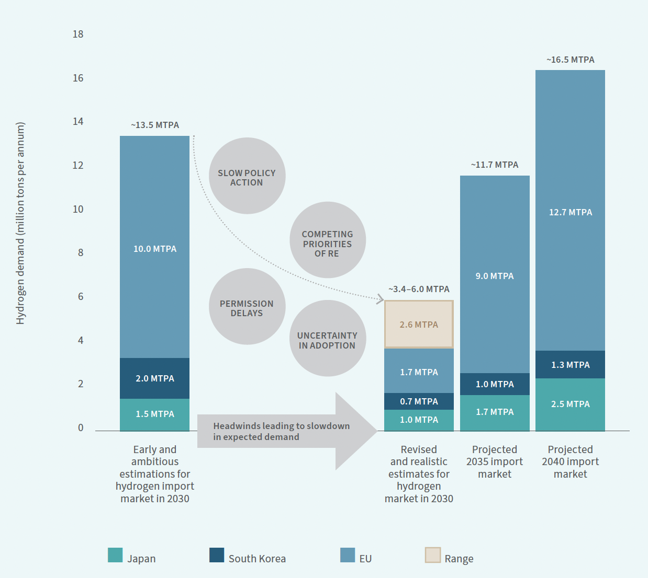
Green hydrogen moves toward strategic focus with global market recalibration
Electrolyser and renewable bottlenecks persist
Projects delayed amid rising costs and financing gaps
Policy shifts and uncertainty slowing progress
Companies re-evaluating project economics
Source: RMI Analysis. Unlocking India’s Green Hydrogen Exports

Slide 11


India has a strategic edge in a recalibrating market
3
Early projects can secure investment and market share
Electrolyser and renewable bottlenecks persist
Companies re-evaluating project economics
1
Abundant solar and wind → lowest-cost H₂ production
4
Strategic global partnerships enabling faster access
Projects delayed amid rising costs and financing gaps
Policy shifts and uncertainty slowing progress
2
Strong domestic demand in fertilisers, steel, refineries
5
Realising EU & Asia demand positions India as a key supplier

Slide 12
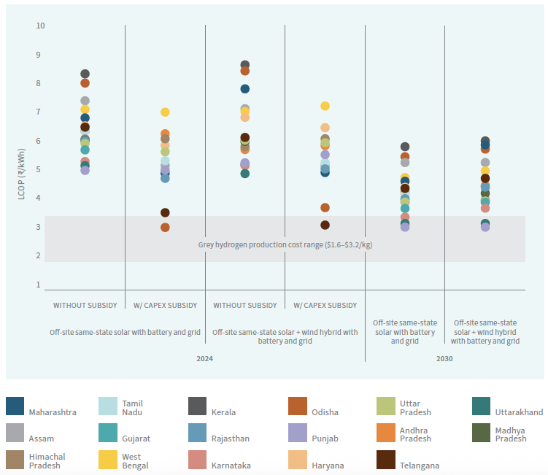




India’s green hydrogen advantage is based on its renewable resource availability and production cost
 | RE Potential 3,700 GW feasible solar & wind potential¹
 | Targets 500 GW renewable capacity by 2030²
 | RE Capacity 237 GW installed, 136 GW in pipeline³
 | Falling RE prices Solar ~ $29/MWh | Hybrid ~ $57/MWh⁴
With incentives, GH₂ < $3/kg — near grey hydrogen range
1. CEEW, 2024; 2. MNRE; 3. Niti Ayog; 4. From the 2025 auction results, considering the 87 INR/$ exchange rate.
Source: RMI Analysis. Green Hydrogen Production Pathways for India

Slide 13
SECI bids are 35–50% lower than global auction prices, confirming India’s cost edge.
- 35%
Tender Overview
1153
724,000 TPA offtake across 13 fertiliser plants
10-year contracts driving domestic green ammonia production
Supported by capex subsidy, electricity charges waivers, and PLIs
744
Unlocked opportunities
Import substitution boosting domestic demand
Hubs and corridors enabling scale and offtake

Slide 14
Early Projects Anchored in Emerging Markets

Slide 15
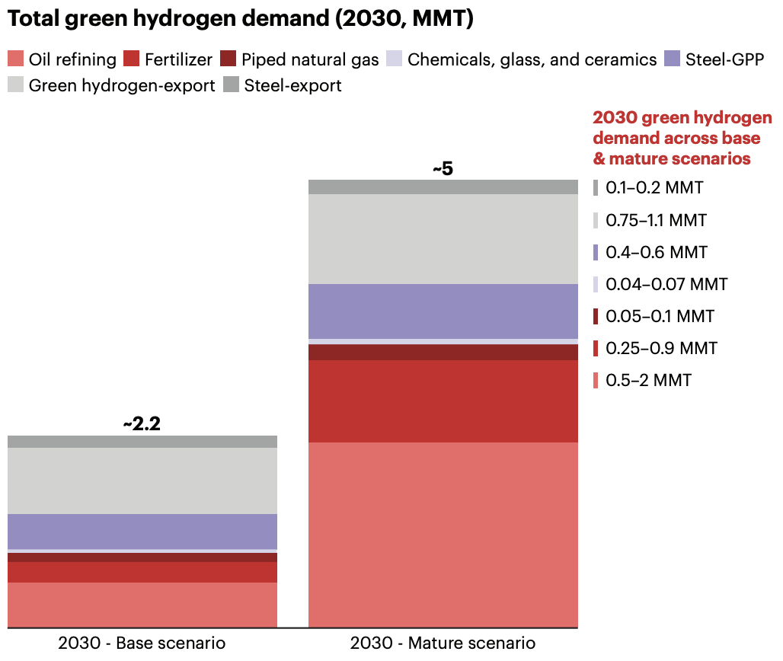
As costs decline, green hydrogen demand could reach ~5 MMT by 2030, expanding use across industries.
Of the 5 MMT target, 2–3 MMT/yr can be achieved through:
- Blending mandates
- Production targets
- Green public procurement
Source: RMI, Bain and CII. From Promise to Purchase: Unlocking India’s Green Hydrogen Demand
Notes:
Notes: (1) Base case: 10% in refinery, 5% in fertilizers, 5% in piped natural gas, 10% in glass/ceramics and chemicals, 10% in green public procurement (GPP) of steel, 5% of green hydrogen export market, 50% of European Union (EU) steel demand; Optimistic case: 40% in refinery, 20% in fertilizers, 10% in piped natural gas, 20% in glass/ceramics and chemicals, 15% in GPP of steel, 7.5% of green hydrogen export market, 70% of EU steel demand

Slide 16
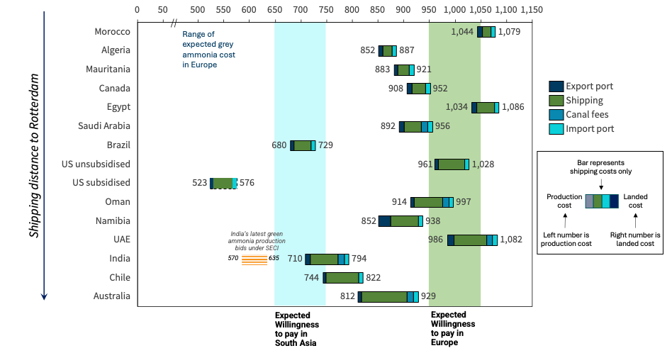
India can serve European and South Asian markets with one of the world’s most competitive green ammonia prices.
Source: RMI Analysis. Unlocking India’s Green Hydrogen Exports

Slide 17
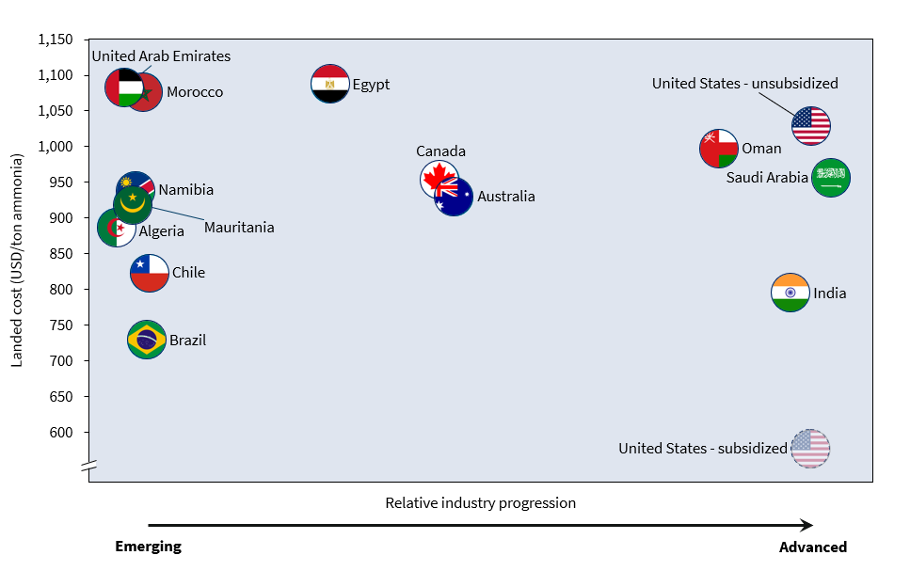




India poised to connect global demand through green hydrogen corridors
Success in the global hydrogen economy will depend on cost and overall ecosystem readiness.
Opportunities Ahead
Green Shipping Corridors
Green Fuel Export Corridors
Multi-fuel, multi-functionality Hubs
Global First-of-its-kind projects
Source: RMI Analysis. Unlocking India’s Green Hydrogen Exports

Slide 18
Enablers: Path from Potential to Scale

Slide 19




Realising India’s potential requires four enablers for scale
Infrastructure Preparedness
Standards & Certifications
Strategic
Partnerships
Trade & Financial De-risking
Develop ports, pipelines, and storage to enable production and exports; shared infrastructure lowers cost and boosts efficiency.
Harmonised standards ensure global compliance and strengthen India’s reliability as an exporter.
Build long-term offtakes, joint investments, and technology collaborations with key markets.
Use contracts for difference and guarantees to reduce market and price risks, improving project bankability.
Source: RMI Analysis. Unlocking India’s Green Hydrogen Exports

Slide 20
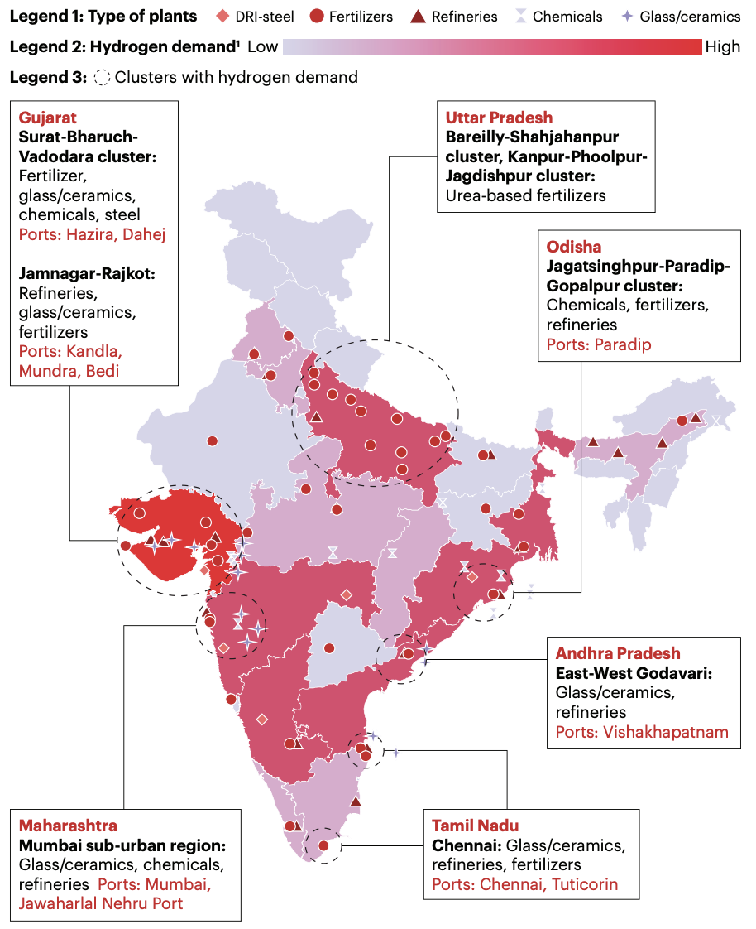
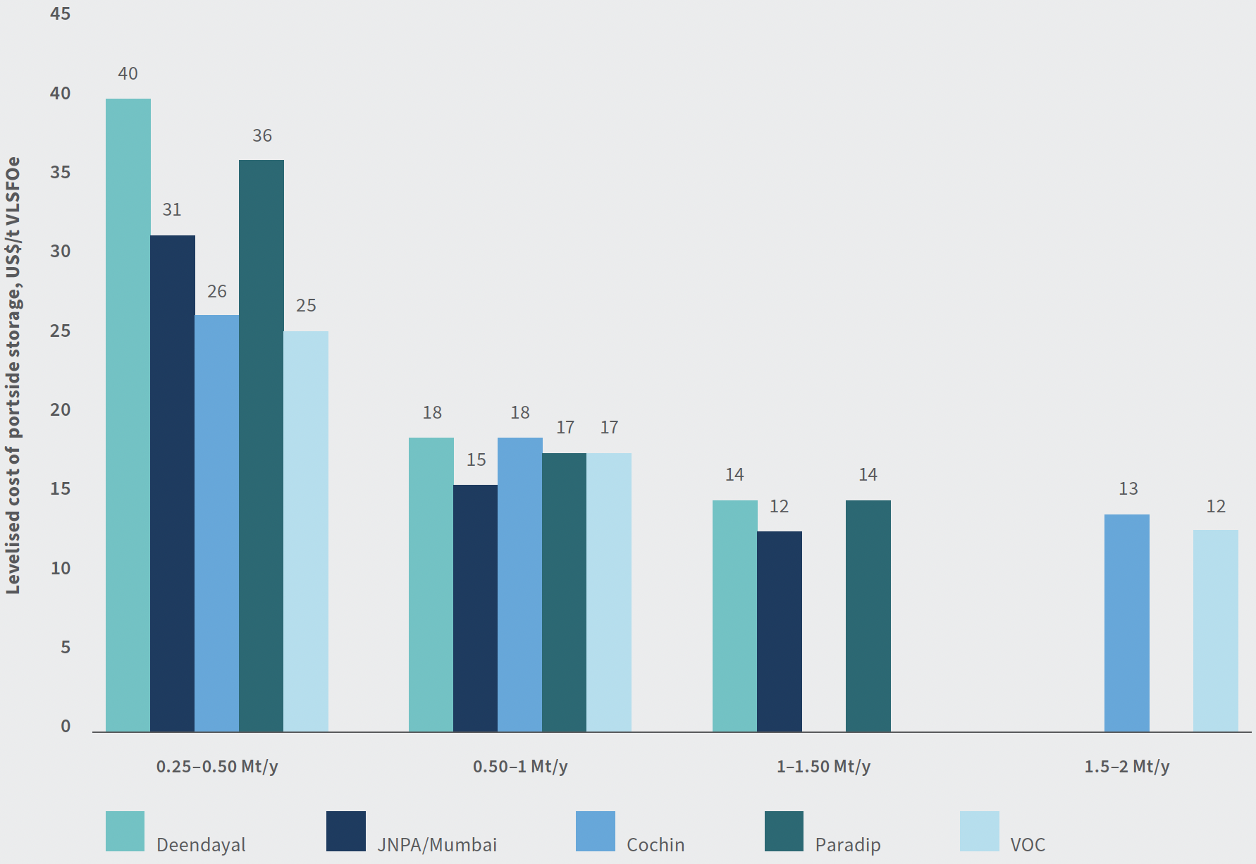
Scaling port-based hubs drives cost efficiency and competitiveness
Ports must evolve as multi-fuel, multi-functional hubs to unlock efficiency through shared infrastructure and scale.
Larger port-side volumes significantly lower storage costs, enhancing project viability and competitiveness.
Source: RMI Analysis. Gateway to Green

Slide 21
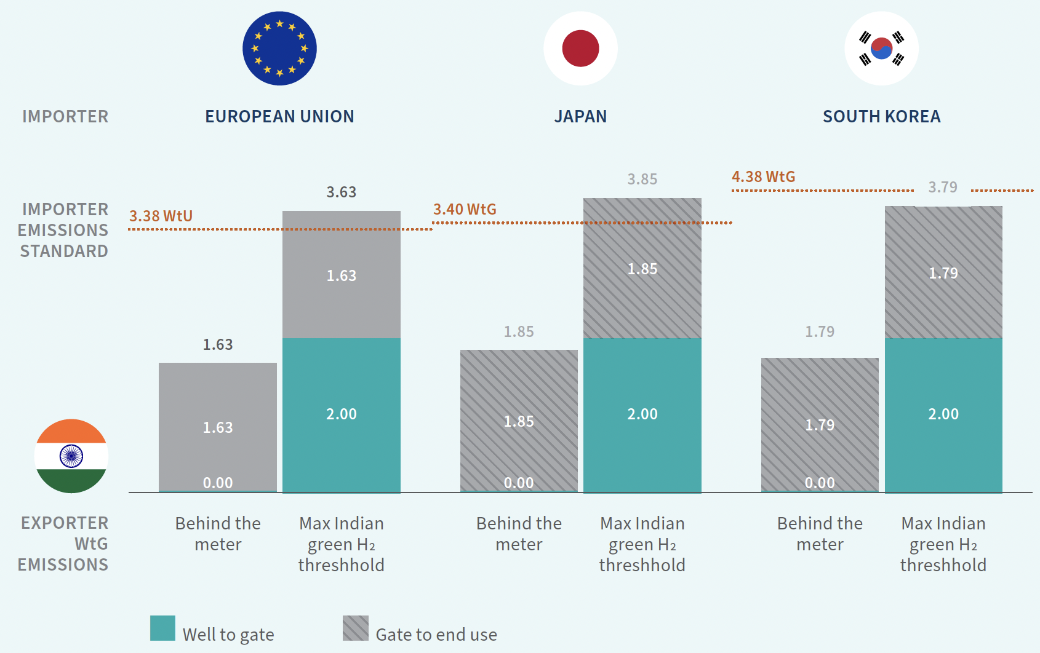
Trade depends on cross-country standards and certification alignment
India’s exports can meet thresholds for the EU, Japan, and South Korea, with harmonised certification enabling access to key markets.
Source: RMI Analysis. Unlocking India’s Green Hydrogen Exports
Notes:
Note: Behind the meter assumes renewables for electricity usage for both hydrogen and ammonia production. Grid electricity represented by maximum allowance of emissions under India’s Green Hydrogen Standard. The EU, Japanese, and South Korean cases show imported ammonia consumed as the end product, with no intermediary step of cracking ammonia back into hydrogen. The ‘gate to end use’ blocks for Japan and South Korea are shaded
because their standards use a ‘well to gate’ boundary, excluding emissions beyond the plant gate from accounting.

Slide 22
Shipping and Trade Corridors: Extending India’s Green Reach

Slide 23
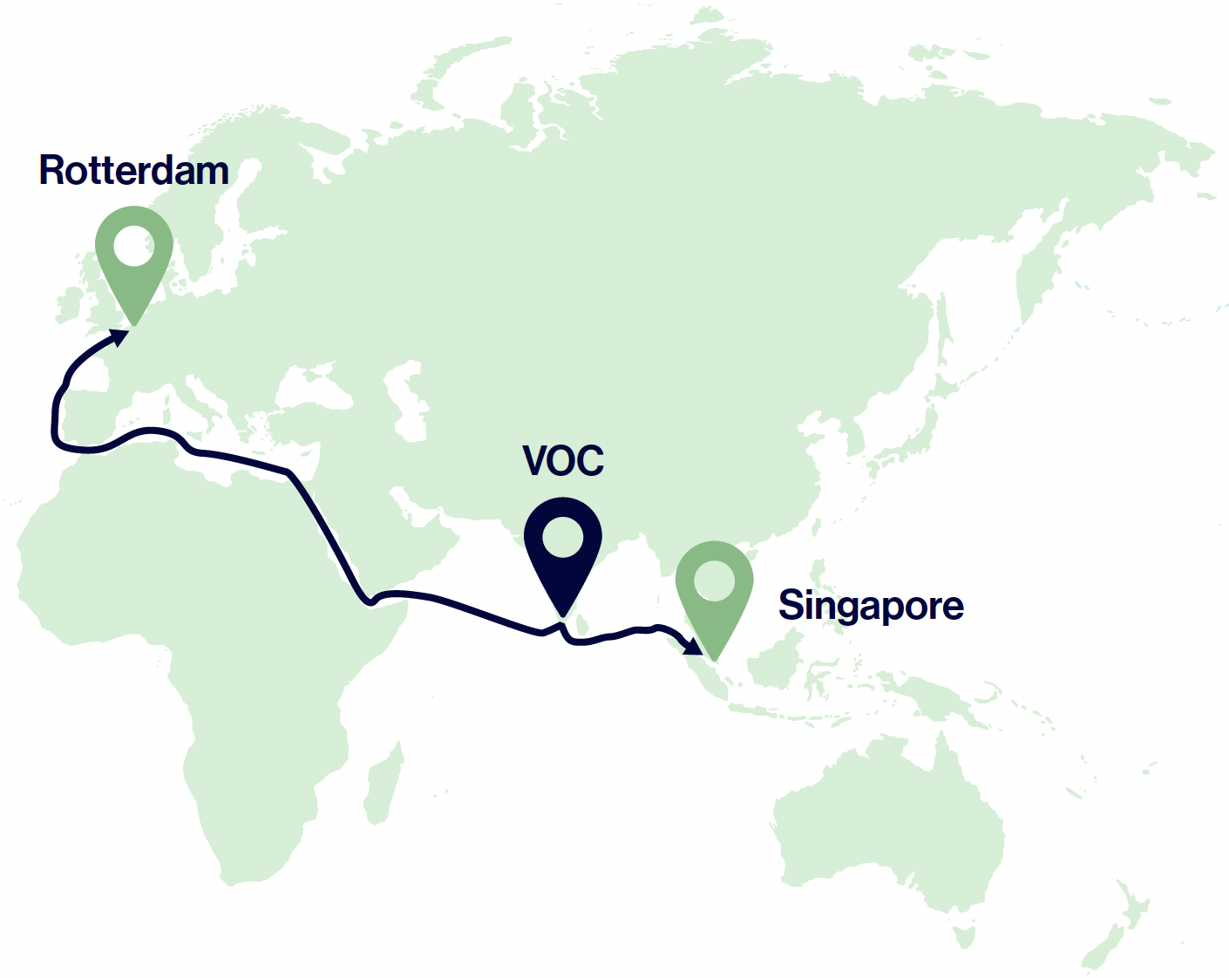
Shipping corridors can unlock scale and global cooperation
Rotterdam–VOC–Singapore corridors open access to 7 Mt/yr green methanol and 11 Mt/yr green ammonia demand across the EU and Singapore.
Drives maritime fuel use of ~300 ktpa methanol and ~800 ktpa ammonia, strengthening India’s export base.
Kandla–VOC coastal corridors can leverage this scale to accelerate India’s own decarbonisation.
Source: RMI Analysis. Sailing Towards Net Zero: Unlocking India’s e-fuel corridor potential

Slide 24
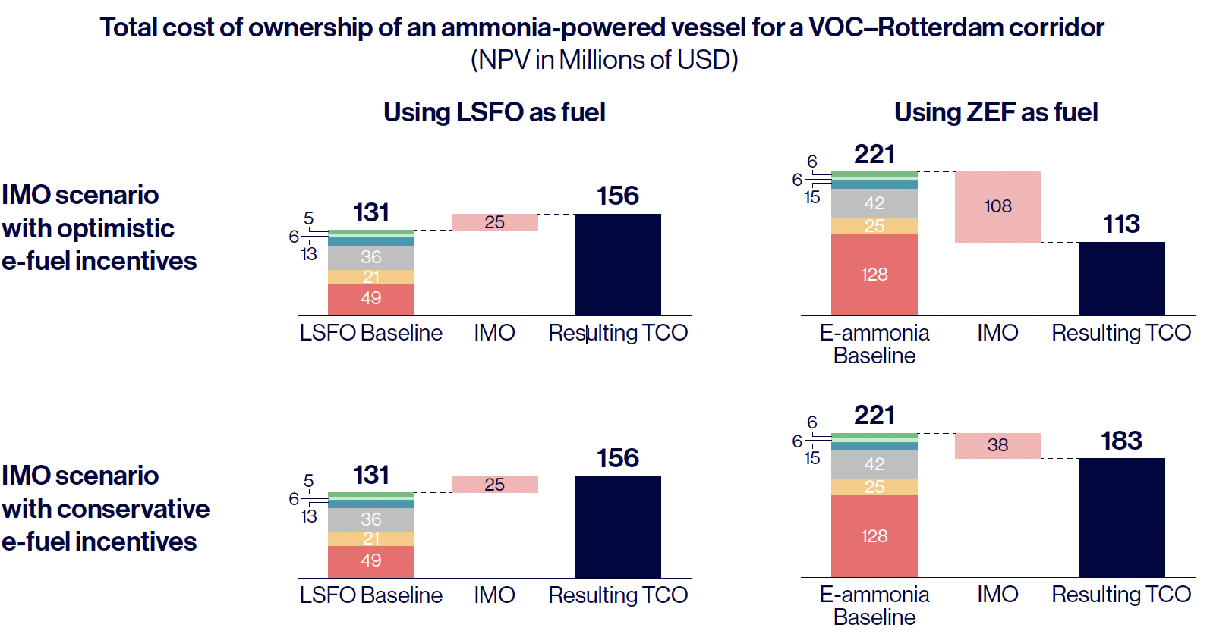
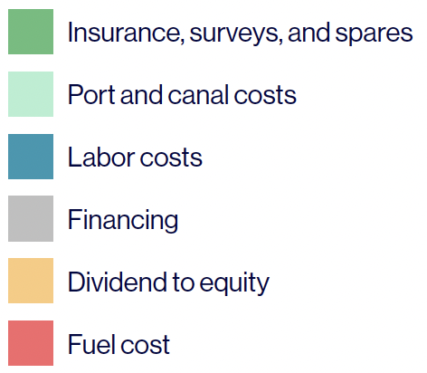
Green fuel shipping remains costly; policy alignment key to parity
Green fuel shipping is ~70% costlier than conventional fuels today.
Coordinated IMO incentives and net-zero frameworks can bridge the cost gap between low-sulphur and zero-emission fuel vessels.
Source: RMI Analysis. Sailing Towards Net Zero: Unlocking India’s e-fuel corridor potential

Slide 25
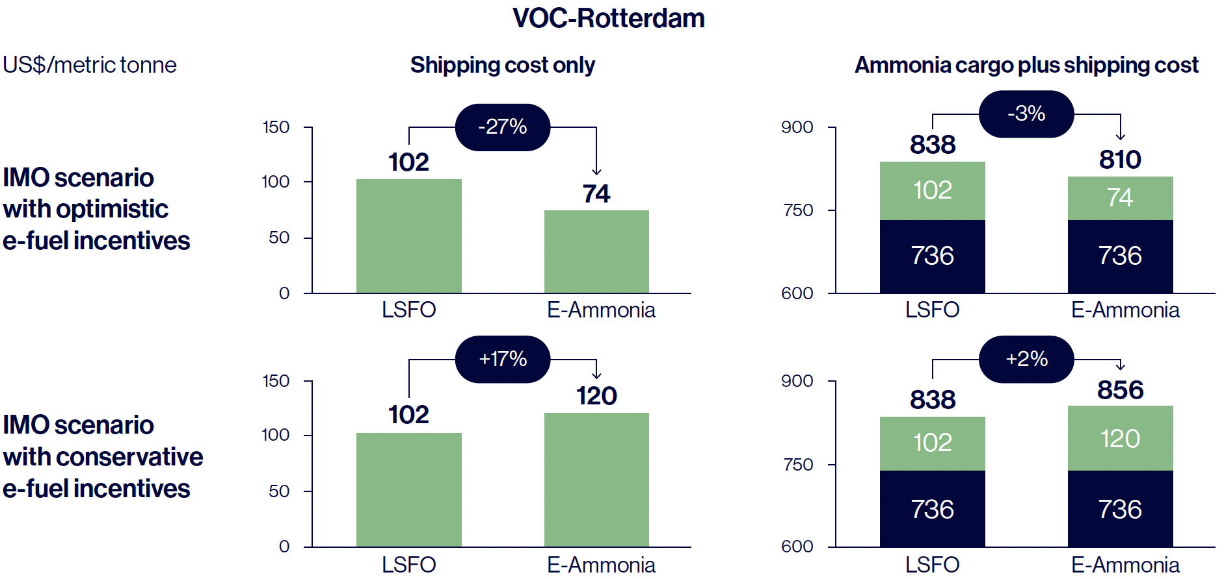
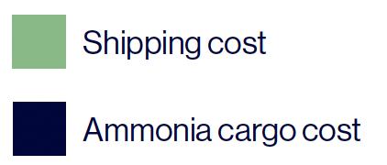
IMO policy incentives can lower delivered e-fuel costs
Strong IMO incentives can cut shipping costs by up to 27%, lowering total delivered ammonia cargo cost by ~3%.
Source: RMI Analysis. Sailing Towards Net Zero: Unlocking India’s e-fuel corridor potential

Slide 26
India’s Next Phase of Growth and Innovation

Slide 27




India is positioning to lead the global green hydrogen ecosystem, setting the stage for the next wave
Focus on fertilizer, refinery, steel, transport sectors.
Enable first-of-its-kind commercial projects.
Build corridors and clusters to scale up.
Promote green shipping corridors for trade.
Source: RMI Analysis. RMI Graphic.

Slide 28
Thank you.

